Slide 1
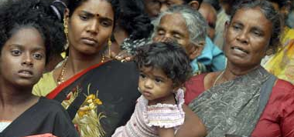

Protection of the rights of Women, Children, Weaker Sections and the Minorities
Siddhant Varshney
Roll no: 21
9th ‘B’ Wandering Minds

Slide 2
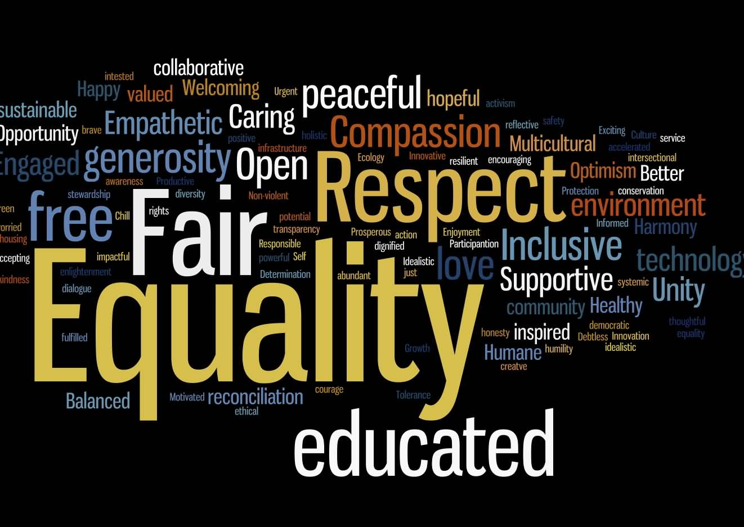
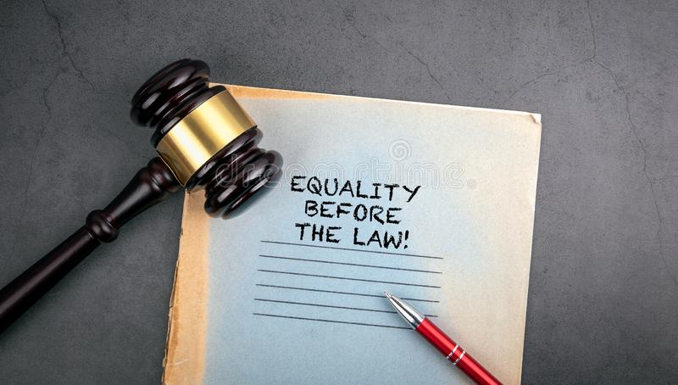
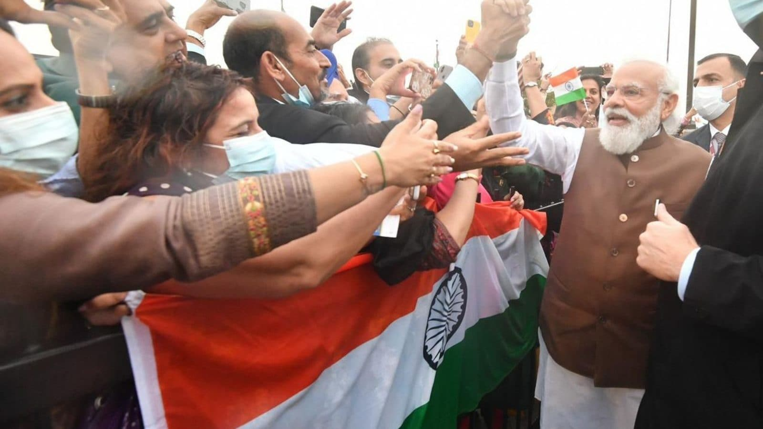
Equality and the Law in INDIA
The Indian constitution is the fundamental documents of the country where the equality is the basic principle. This documents consist of Article 14 which emphasize on “EQUALITY BEFORE LAW” which means every citizen of this country are to be treated equally and no one will be discriminate or deprived by law. Article 14 of the Indian constitution also provides the protection for every individual within the territory of India.
I mentioned this Article on the top paragraph because this provision of our constitution is providing the equality to every individual of the country and those individual includes children, women, minorities and as well as weaker section of the society.

Slide 3
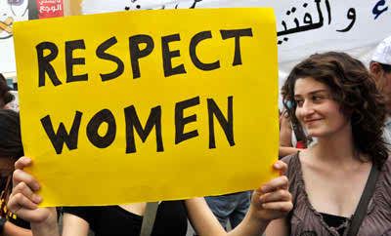
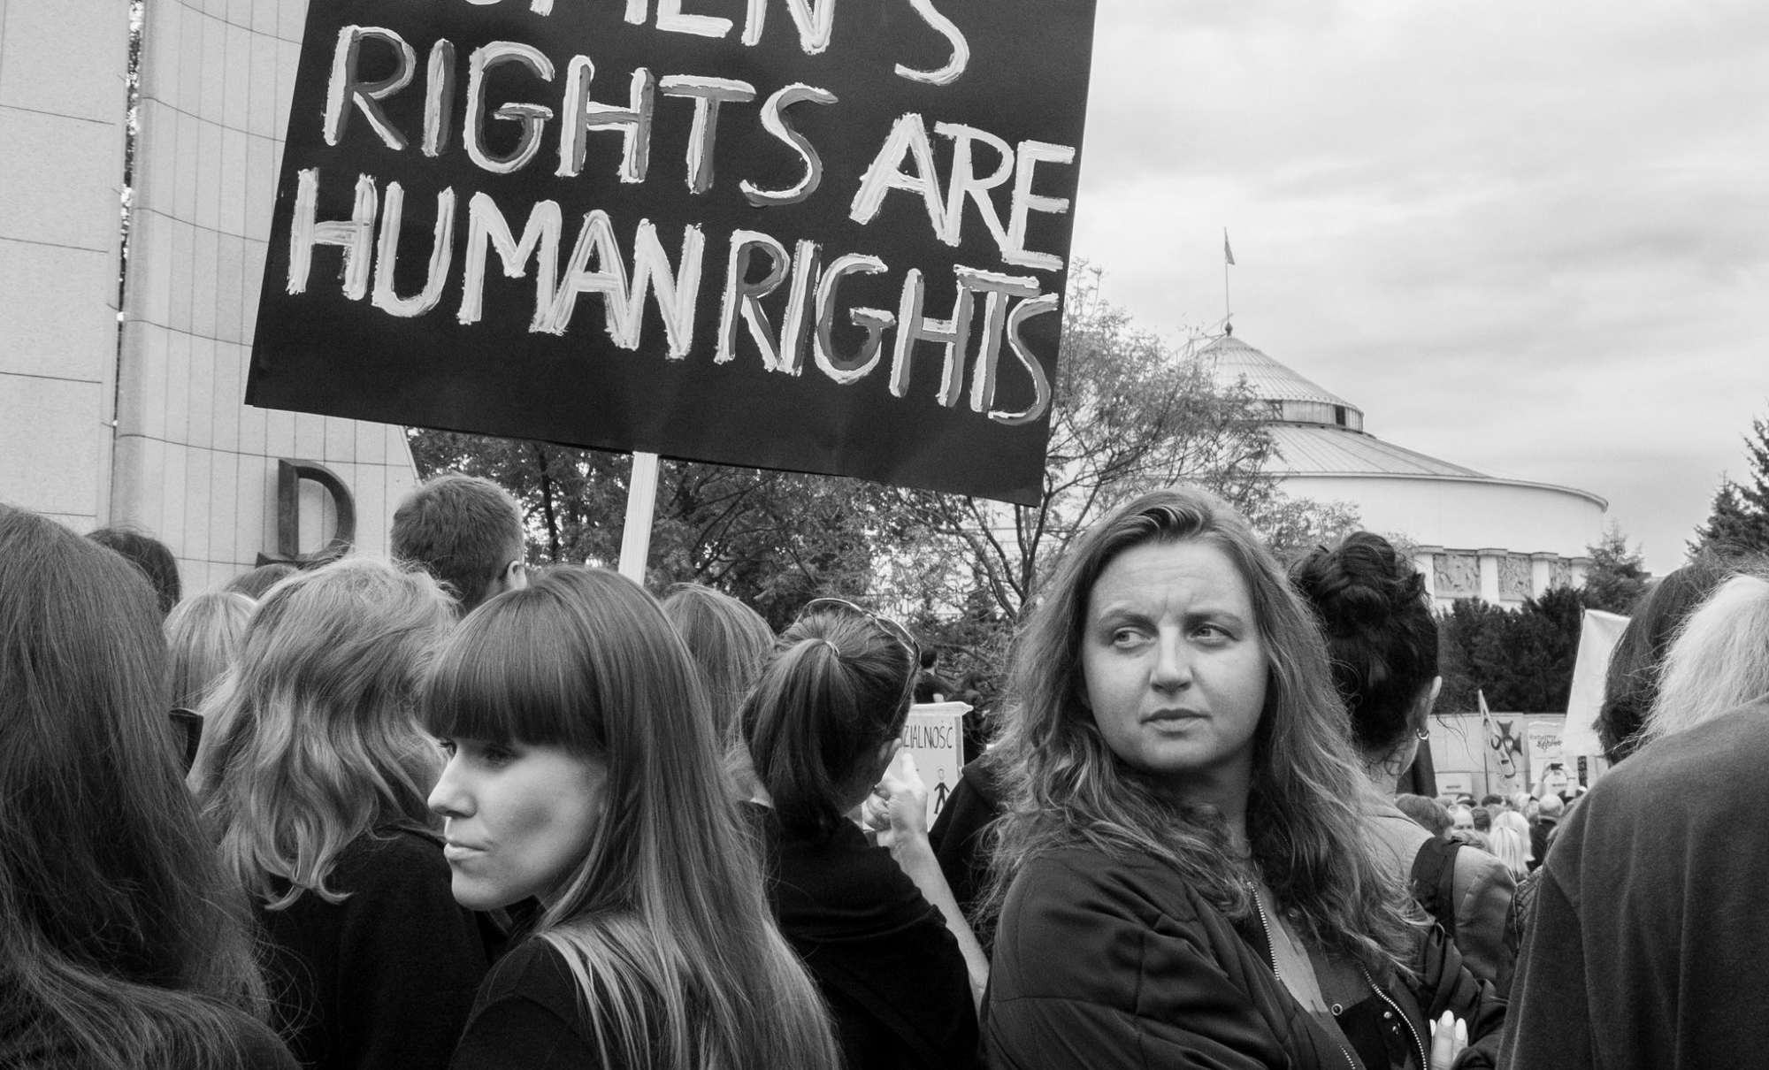
Rights of Women
Women did not have access to education, had no say in the matters that impacted them the most, and the role of women in marriage was insignificant, with parents selecting a groom for them. Altogether, the role of women in society was to make sure that they were obedient wives and caring mothers.
I already mentioned Article 14 of the Indian constitution which talks about the equality before the law and equal protection of the law. Irrespective of this, there are several provisions under the constitution which protects the right of women.

Slide 4

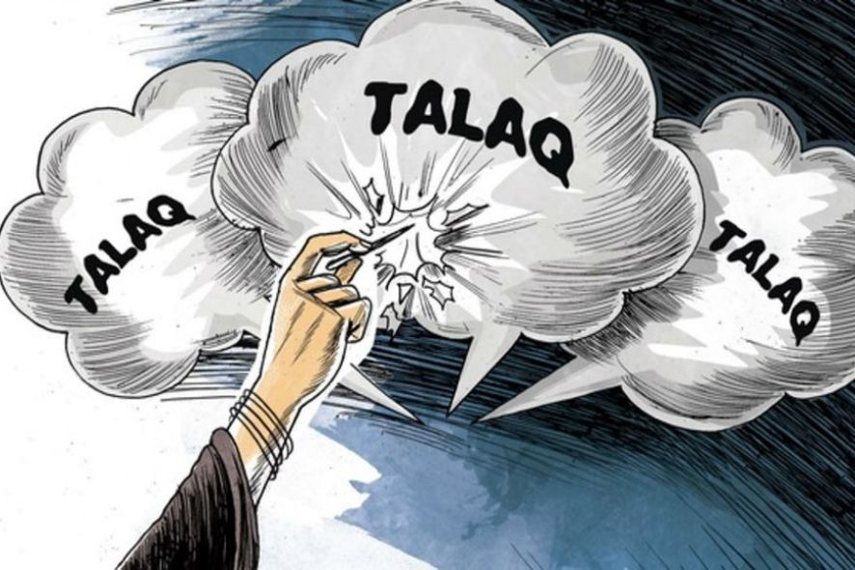
Protection of women
I already mentioned Article 14 of the Indian constitution which talks about the equality before the law and equal protection of the law. Irrespective of this, there are several provisions under the constitution which protects the right of women.
Article 15 of the Indian constitution safeguard the women’s rights through the policy of non-discrimination. This provisions clearly emphasize that the state shall not discriminate against any citizens on grounds of religion, caste, sex (gender) and place of birth.
Apart from these provisions, our constitution also provides protection to the women through Article 16. Through this provision, it’s providing the equal opportunity in matters of public employment without any discrimination on the ground of caste, sex (gender), religion, etc.

Slide 5


Rights of Children
The children play a big role in the development of a society because they are the future. When these children grow up, they are the people who will continue what the adults contributed; they may improve, create and teach the next generations on how to take care of the society.
Every child has the right to an education. Primary education should be free. Secondary and higher education should be available to every child. Children should be encouraged to go to school to the highest level possible.

Slide 6


Protection of Children
Indian constitution provides the protection to the right of children through Article 21-A. Article 21-A of the Indian constitution protects the educational right of the children who are between the ages of six to fourteen years. This Article stated that “the state shall provide free and compulsory education to all children” (between the ages of six to fourteen years).
Apart from this provision, Article 45 also talks about the protection of the right of children through provide the early childhood care and education (until they complete the age of six years). This provision is the part of the directive principles of state policy which is not enforceable by the court of law.

Slide 7
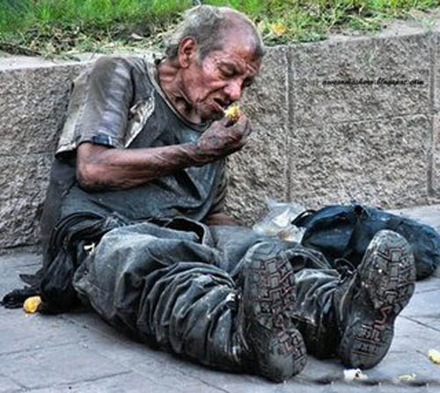
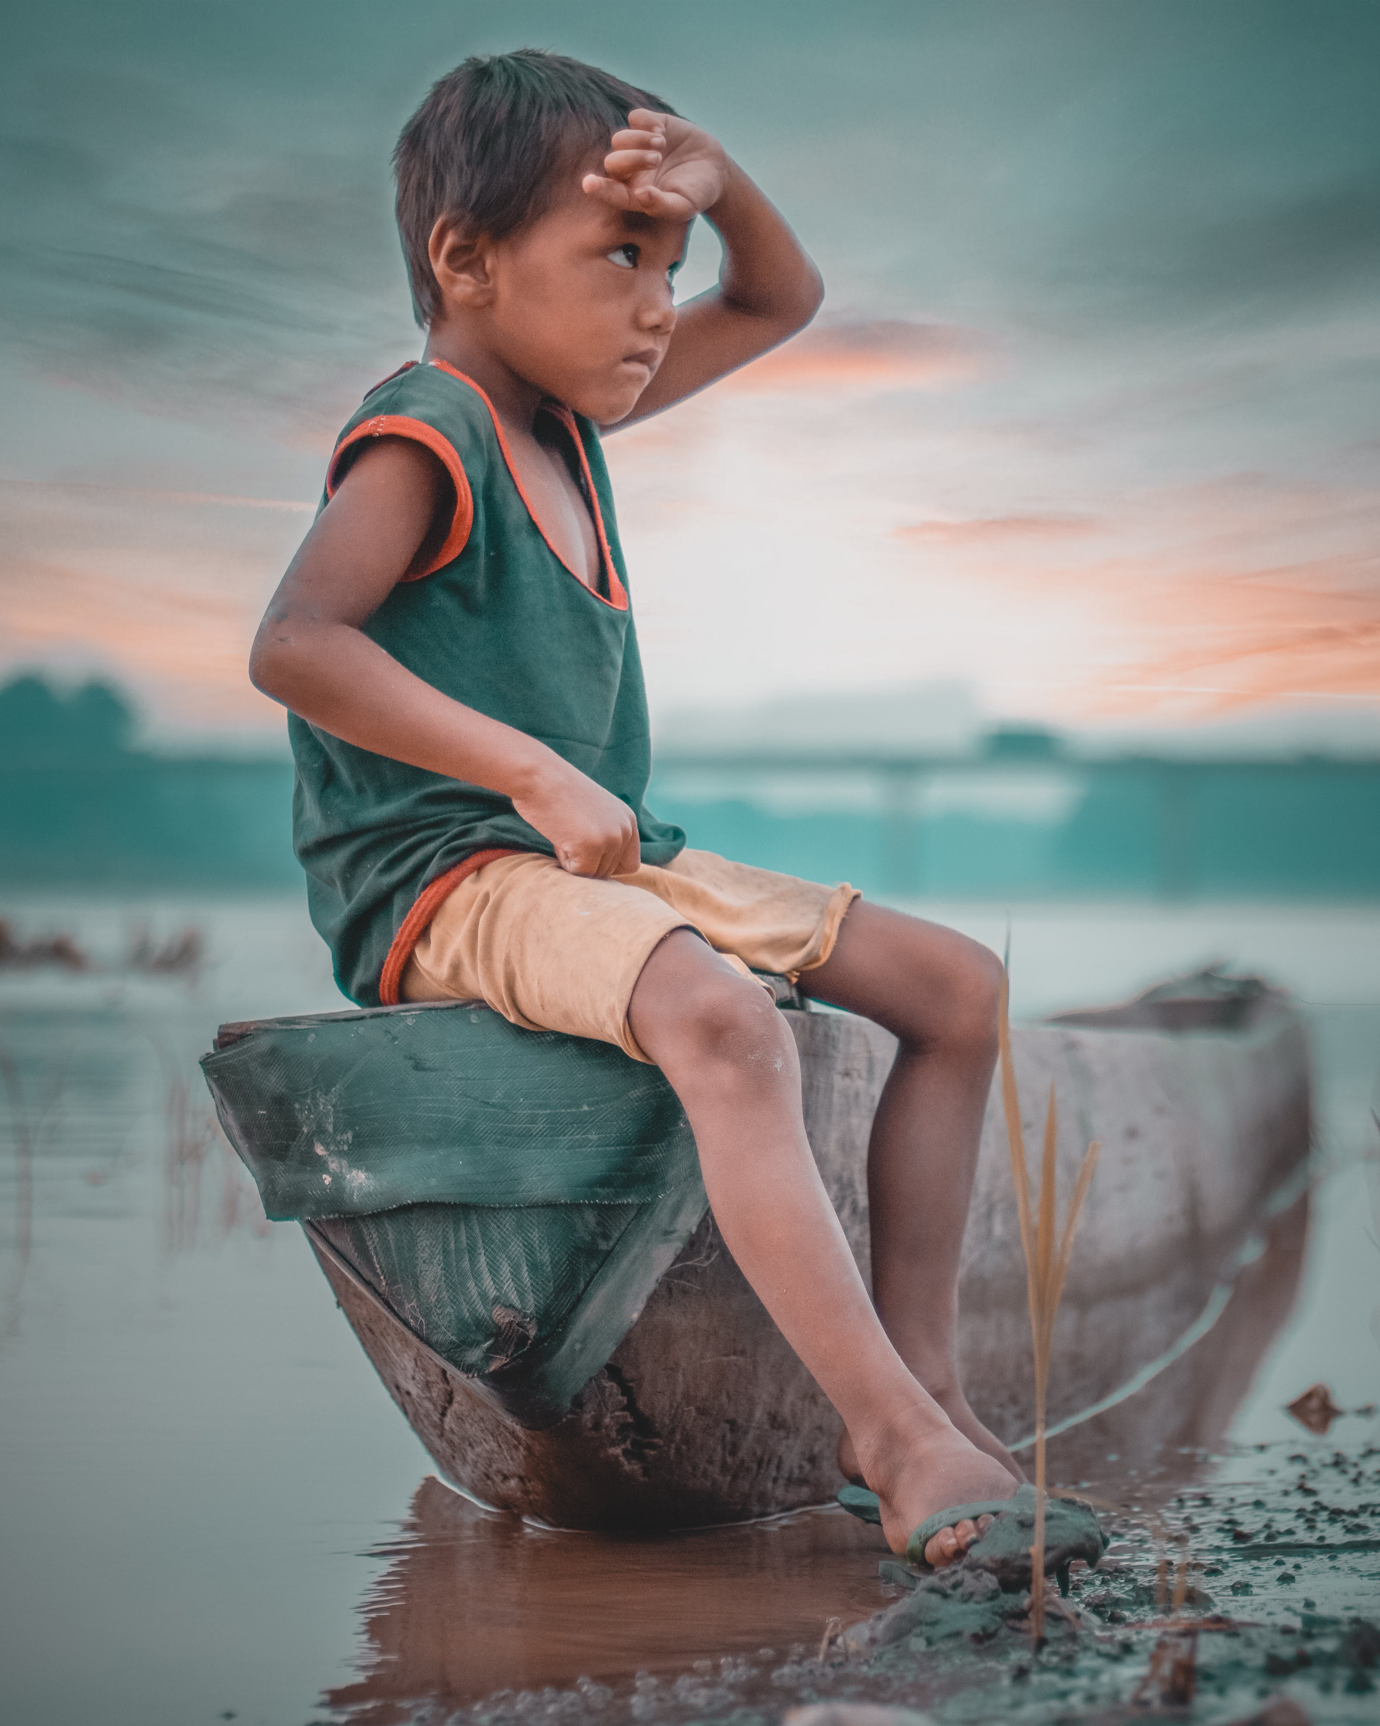
Rights of Weaker Sections and the Minorities
As a part of the fundamental right of the minority community, constitution provides the safeguard on the language, script and or culture of the different minority community through Article 29 (1). And at the same time, Article 29 (2) provides the right to the minorities to take admission into any educational institution without any discrimination.
Simultaneously various constitutional and statutory bodies like Commission on Scheduled class, Commission on Scheduled tribe, women rights commission, and Human rights commission etc. were constituted to ensure that no discrimination is done by dominated section of society and authorities against weaker section.

Slide 8
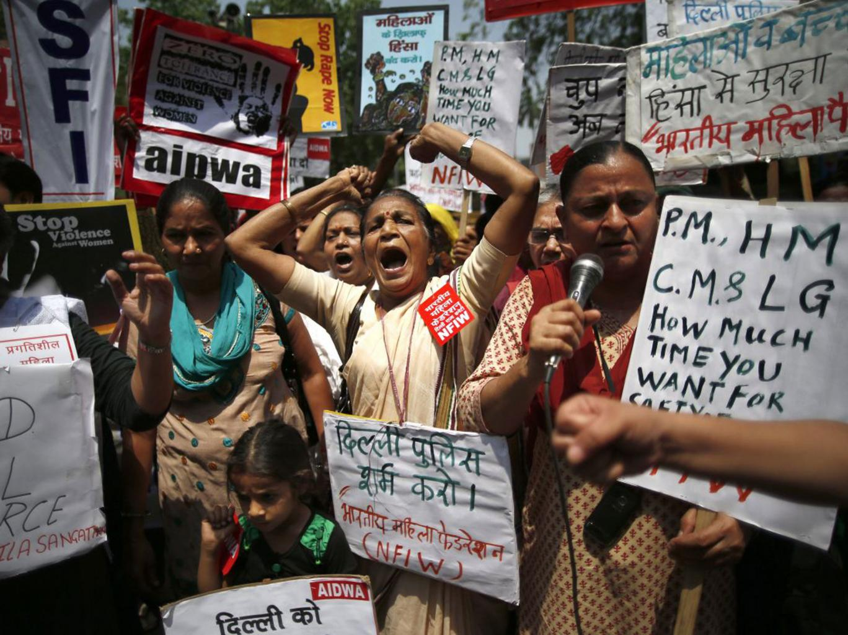
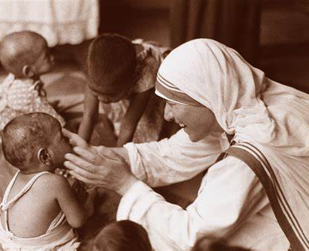
Protection of Weaker Sections and the Minorities
Our Indian constitution not only talks about the right of women or children but also emphasize on the protection of minorities and weaker section of the society.
Constitution provides many rights to the minorities through various provisions to ensure the equality among the people and to maintain the diversity of our country.
As a part of the fundamental right of the minority community, constitution provides the safeguard on the language, script and or culture of the different minority community through Article 29 (1). And at the same time, Article 29 (2) provides the right to the minorities to take admission into any educational institution without any discrimination.
Apart from these provisions our constitution also provides right to the minority communities (under article 30) to establish and administered educational institutions based on their religion and language.

Slide 9
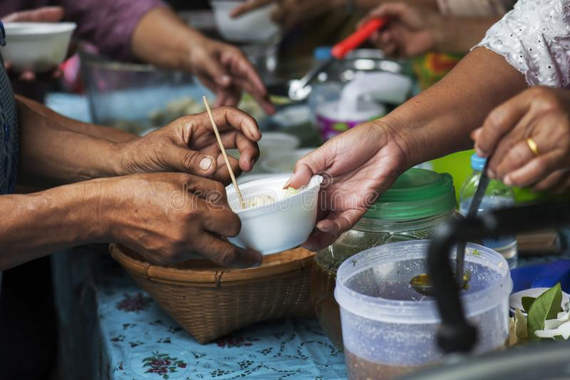
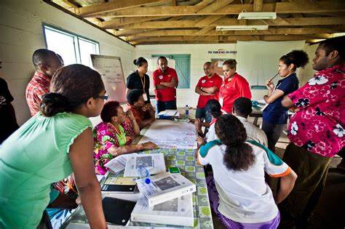
Helping the society
Help people out during everyday life when you have the opportunity. While they may not be glamorous, small gestures of kindness at a one-on-one level are a great way to be useful in your community. When you spot an opportunity to make a direct intervention and help another person in your community, do it with a smile. Volunteer at a community organization to help others in society. Volunteering is a great way to interact with your local community and help out people who are less fortunate than yourself. Volunteering will only take a small amount of your time each week and can make a huge difference in the lives of people in society around you.

Slide 10

Thank You

